Slide 1
Contracts with Recruiters

Slide 2
Signing contracts
Right to represent:
OK if it is for one particular position and for certain length of time.
Be careful not to sign contract that says if offered the job you must take the position.
Some might ask you not to accept any other offers before receiving answer from client about you.

Slide 3
Additional Info
Background check – no Masters degree yet
Security clearance-allows access to classified or restricted information after thorough background check. Company must apply for you.

Slide 4
Right to Represent - Good
I, John Smith, agree on “6/6/17” to be represented solely by The Brixton Group for purposes of my candidacy for the “Accenture/T-Mobile – Frontend UI Developer (Angular)". I have not and will not apply directly to the “Accenture/T-Mobile – Frontend UI Developer (Angular)" and I am not represented nor will seek to be represented by another agency in pursuit of the “Accenture/T-Mobile – Frontend UI Developer (Angular)" for the next 90 days.

Slide 5
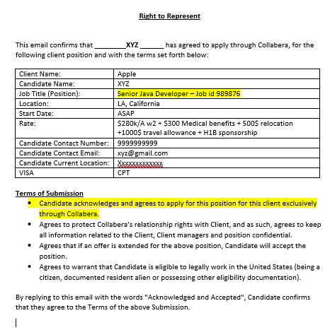

Slide 6
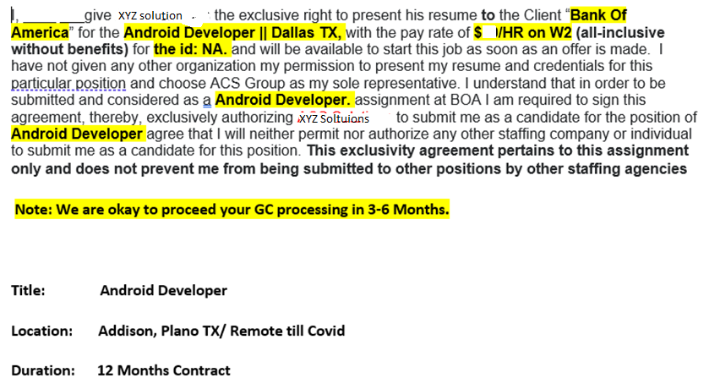

Slide 7
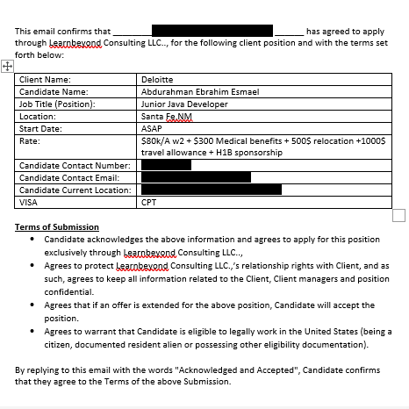

Slide 8
Working with Recruiters
Your gateway to clients
Establish relationships for future career in U.S.
Create folder for best contacts
Be prompt in your response to their inquiries
You do not have to work with all recruiters
No two jobs

Slide 9
Right to Represent – Not good
By signing below, you agree to allow MSys Inc to submit your resume exclusively for this position. You also certify that you have no letter of commitments pertaining to this Requisition with any other company at this time. If chosen, you must be available to accept employment by the project begin date of 12/9/2013. You also certify that you are authorized for work in the United States and would be able to provide proof of work authorization upon offer.

Slide 10
Working with Recruiters & Filtering Calls
Do not waste your time with recruiters you don’t want to work with. This is your job search.
80% of calls from recruiters are not productive.
Ask to see a job description.
Falsify your resume – “NO and NEVER”

Slide 11
No Job Description
You: “Thank you for your call. I am very interested in a (job title) position. Do you have any openings for that?
Recruiter: “Yes I do.”
You: “Can you send me the job description please?”
Recruiter: “I have many openings and will find the right job for you. I will market you to our clients.”
You: “When you have a job description, please contact me at that time and we will proceed.”
If “yes” to sending you a job description, then proceed with the screening interview.

Slide 12
Recruiters to Avoid
You don’t have to work with pushy, aggressive recruiters. It’s your job search.
Do not work with recruiters who want to falsify your resume.
If you consent to using false information, it will eventually be revealed. Bad news when found.
Employer will never tolerate dishonesty.
Protect your reputation! It will follow you.

Slide 13
Main Reasons for CPT Delay
Poor communication
Restrict to one geographical location
Ask for too much money
Delaying starting your job search

Slide 14
Asking for personal info like I-20, License, etc.
Recruiter: Can you send me your Drivers License and SSN?
You:
I can send you the last four of my SSN and a letter from my university that explains more about CPT.
Or
I’d be happy to provide this once I’ve moved further in the process.
Or
Once I know about the opportunity and company, I can send that to you in an encrypted email.
You want them to know you will provide documents in the future once you have more information.

Slide 15

Michelle Obama
“We learned about honesty and integrity…that the truth matters…that you don’t take shortcuts or play by your own rules…and success doesn’t count unless you earn it fair and square.”

